Slide 1
Welcome to Open House/Resource Fair 2025
Irvine Adult Transition Program (IATP)

Slide 2
Hello and Welcome, I am Karena Gibbs, Administrator of the IATP program.
We have a short presentation before classrooms and the Resource Fair are open!
Website: http://web.iusd.org/iatp/
Instagram: irvine_iatp
General Phone: 949-936-8150

Slide 3
Objectives
Share with incoming families and current families core components of the Adult Transition Program (IATP). Discuss Specialized Academic Instruction, Work Experience and Travel Training. Discuss the SEALS program and share about our community partners and programs.
Open classrooms and Resource Fair will follow

Slide 4
IATP Staff
Teaching Staff:
Emily Struemph
Shaun Beutner
James Blackburn
Mitch Buchanan
David Ferrell
Daniel Kilpatrick
Laura Maldonado
Andy Marin
Sally Morales
Jeremy Nester
Vy-Vy Vogler
Support Staff:
Karena Gibbs, Site Administrator
Michelle Kim, Office Assistant
Michele Kane, Office Assistant
Christine Duncan, Psychologist
Courtney Belzano, Program Specialist
Ben Youngstrom, Speech Pathologist
Julie Contreras, Speech Pathologist
Janet Penny Cook, Nurse
Tiffany Montes, Occupational Therapist
Heather DeGuelle, Physical Therapist
Dione McCrea, Adapted Physical Education

Slide 5
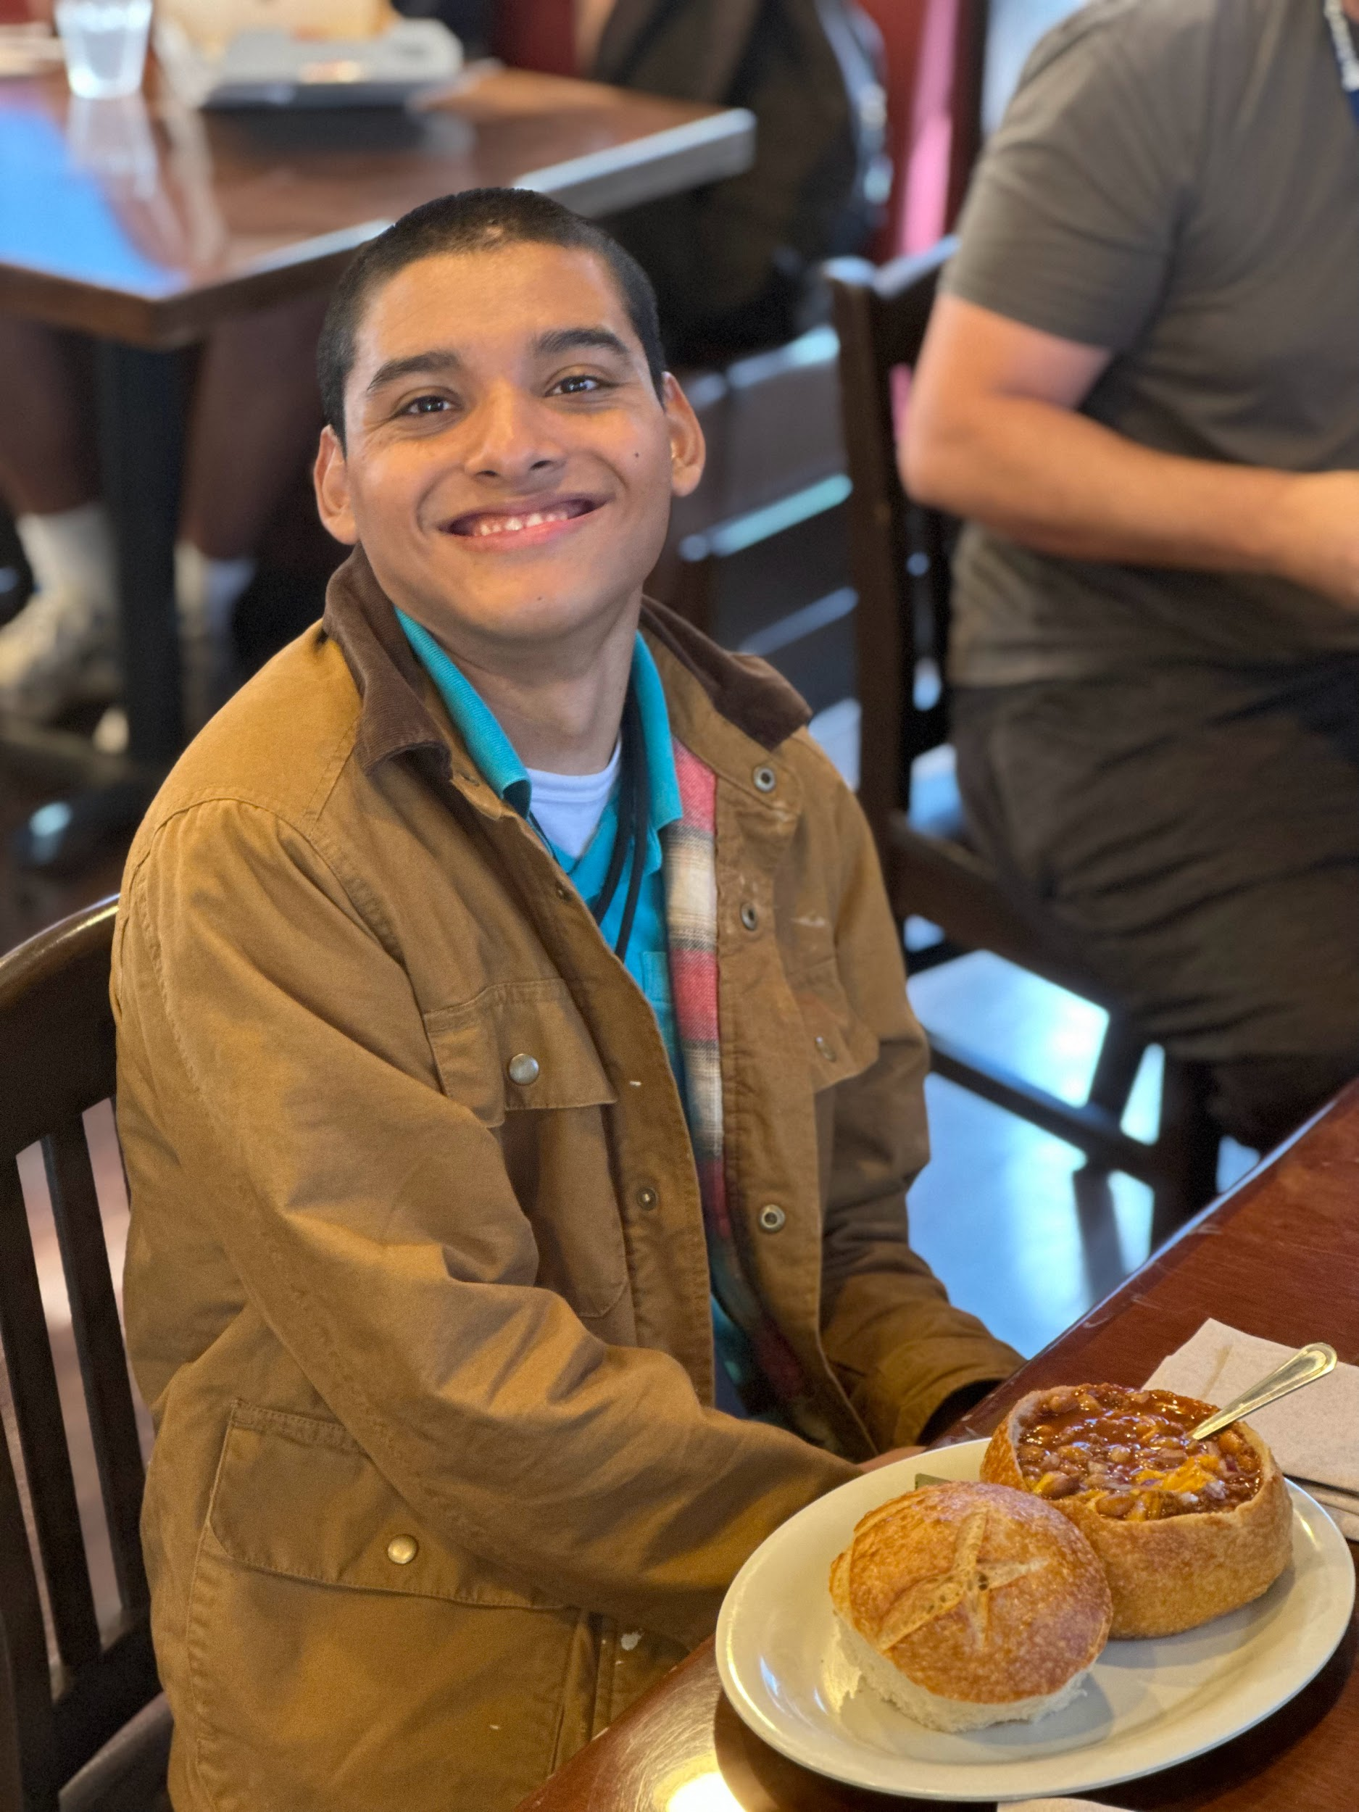
Who are the adults served at IATP?
All students, 18-22 who live in Irvine and leave high school with a certificate of completion and continue to demonstrate the need for transition services. This includes students on the alternative path to a diploma from high school.
7-Extensive Support Needs
1-Medically Fragile
3-Autism Specific

Slide 6
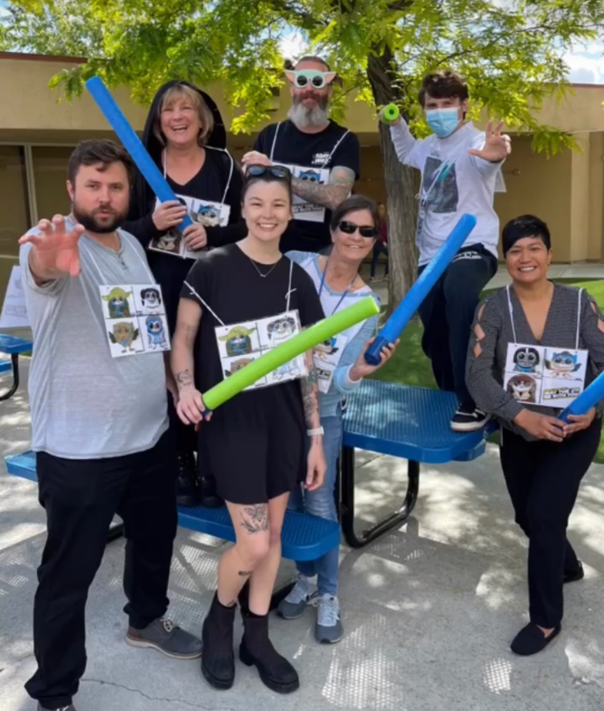
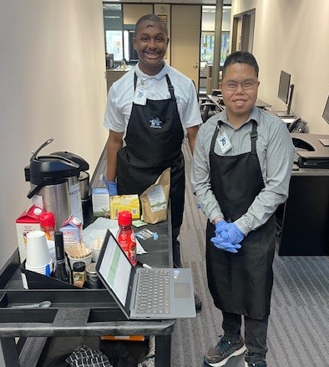
School Schedule
IUSD Secondary School Calendar
Monday-Friday 9-3:00pm
Wednesdays 9-12 noon (Early Out)
Some Fridays are early out
No bell schedule- Home Room
Classrooms may change
Free Lunch Program

Slide 7
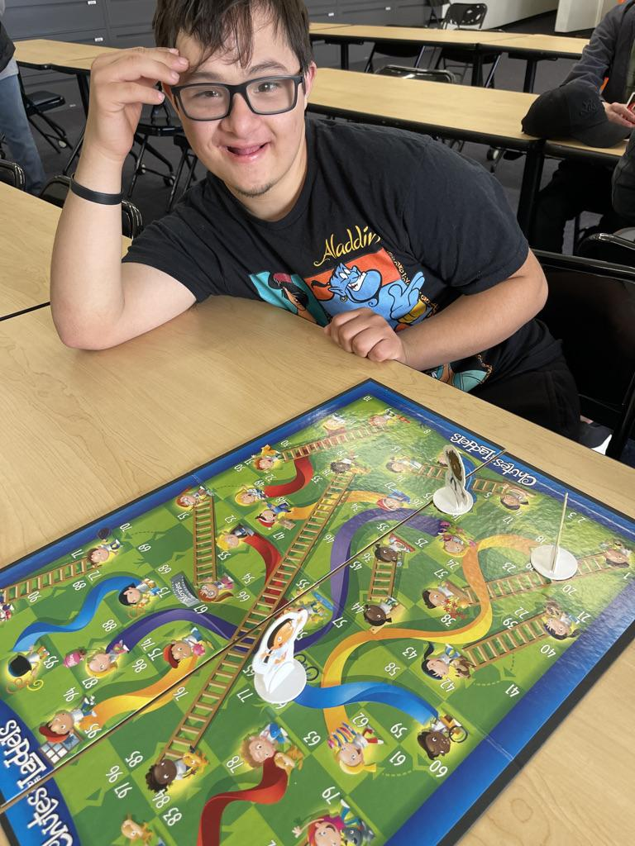
Individual Transition Plan (ITP)
Transition Curriculum
Education/Training
Functional Academics, Communication
Employment
Work Experience, Interest Surveys, Soft Skills, practice skills
Independent Living Skills
Safety, self-care, hygiene, lunch program, budgeting, travel training

Slide 8
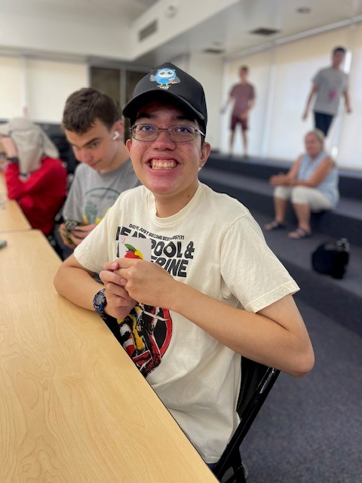
Person Centered Plan (PCP)
Person Driven Plan (PDP)
The purpose of this informal meeting is to discuss and gather information that will guide decisions to improve the quality of life for the student so that they can become contributing members of our society. Students become self-determined when they are empowered to make choices that match their interests.
Connect families and students to community resources.

Slide 9
Focus in Last Two Years at IATP
Start OC Access
Participate in Irvine Disability Services Programming
Start Classes at Coastline Community College
Participate in RCOC transition trainings
Conservatorship
Housing Options
Cal Able Accounts

Slide 10
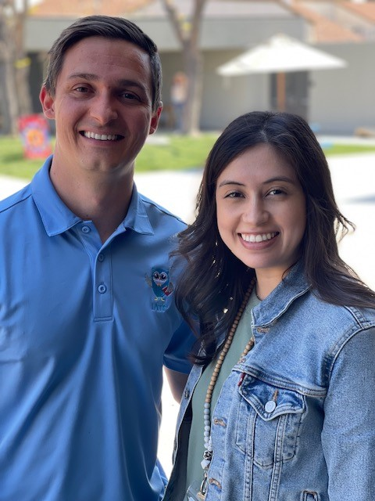
Speech at IATP
Push-in/Collaboration: Intervention within the classroom or community, generalizing skills in their LRE
Pull-out: Sessions in the speech room, introducing new skills not practiced in classroom or community settings
Serviced as Individual or Group

Slide 11
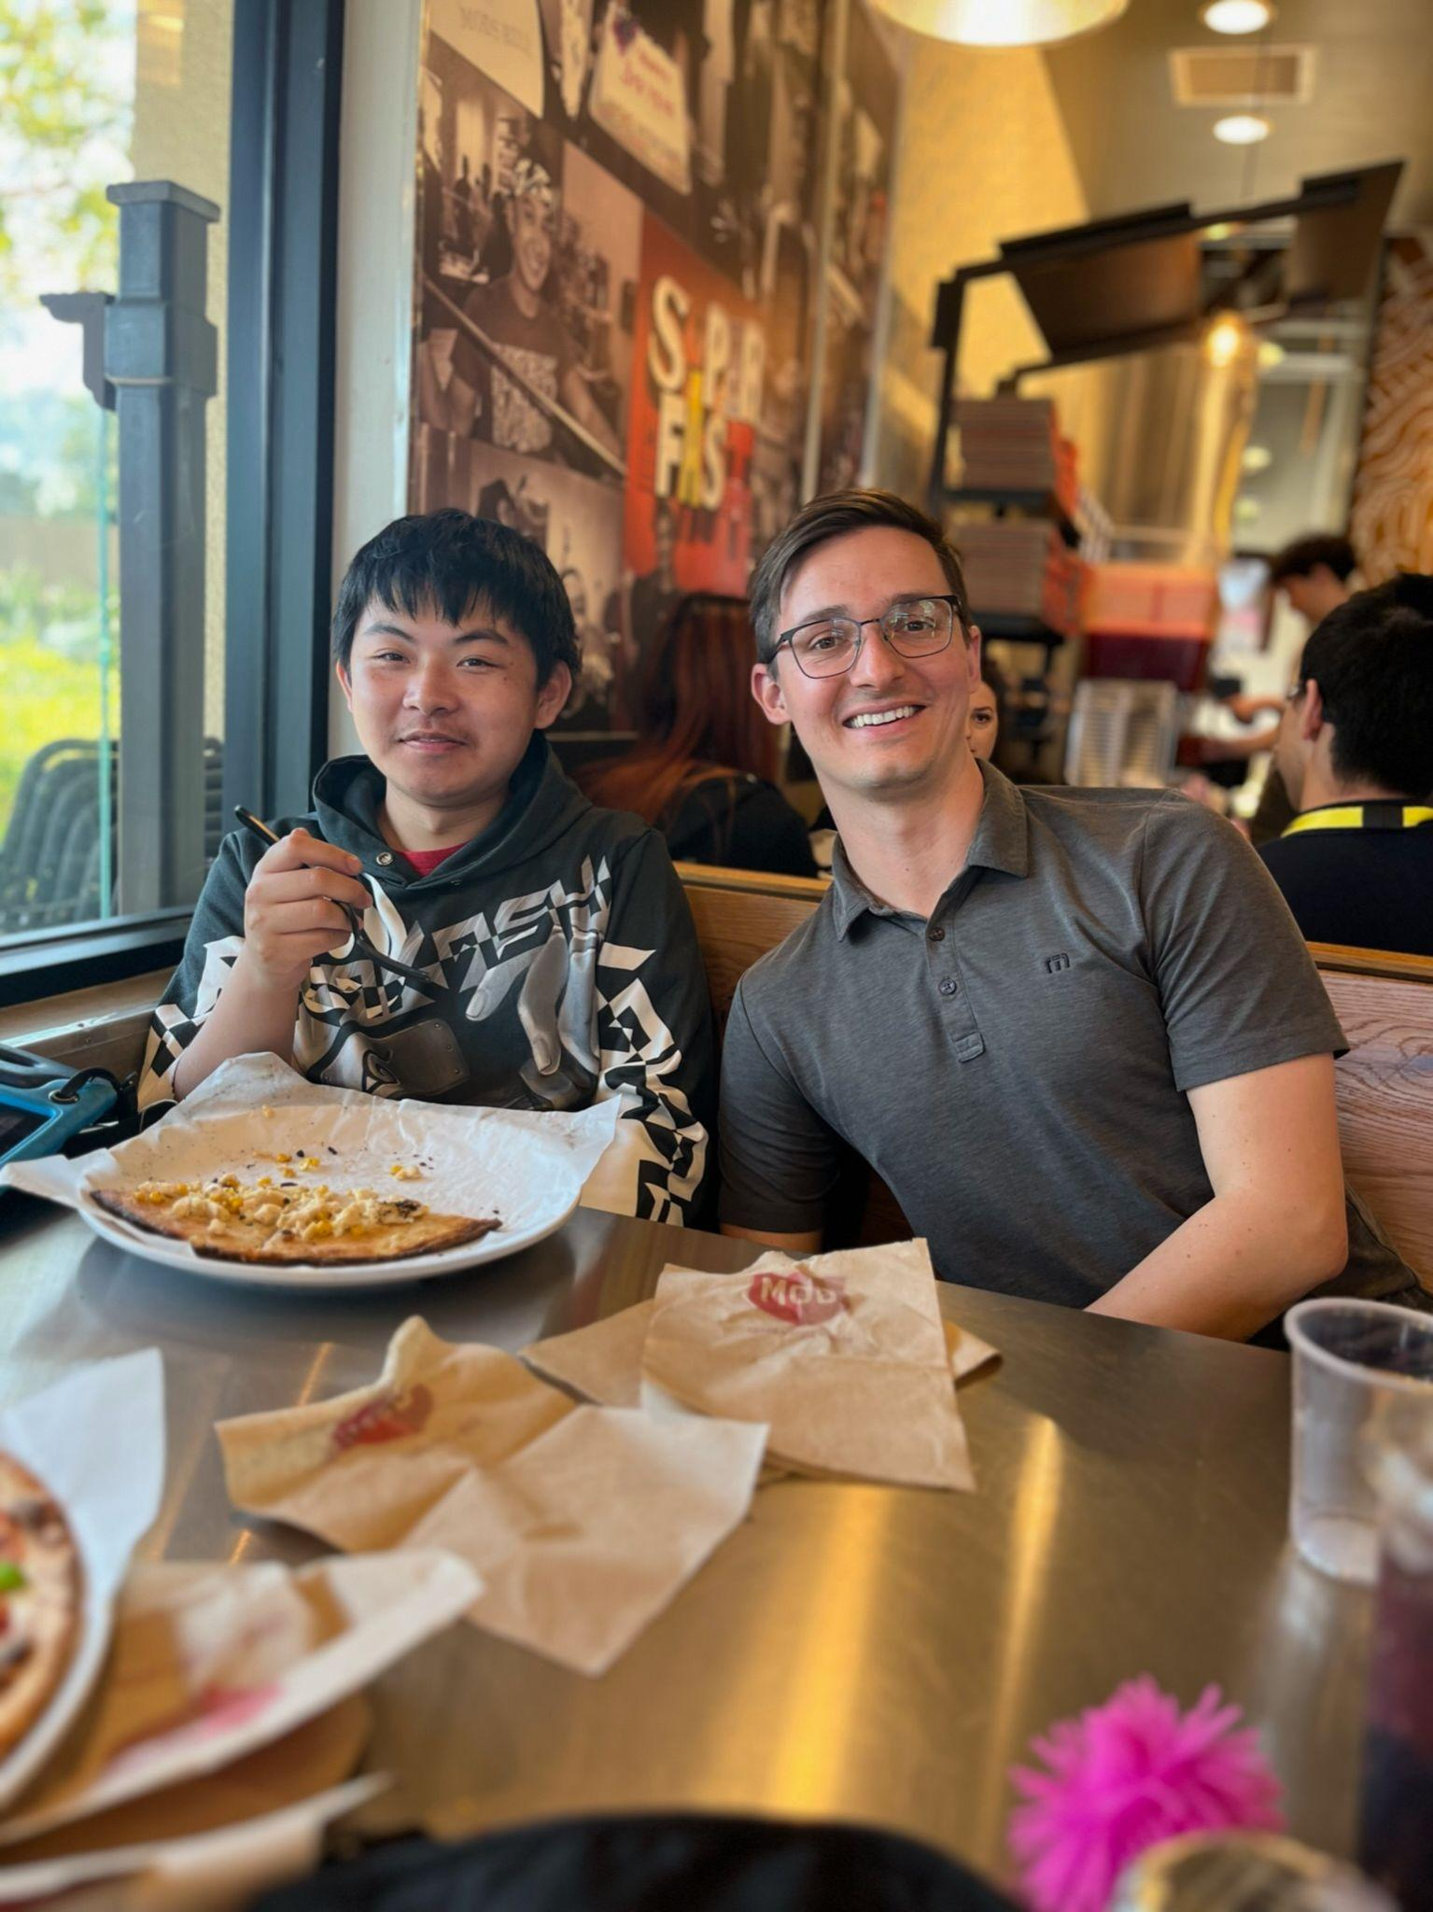
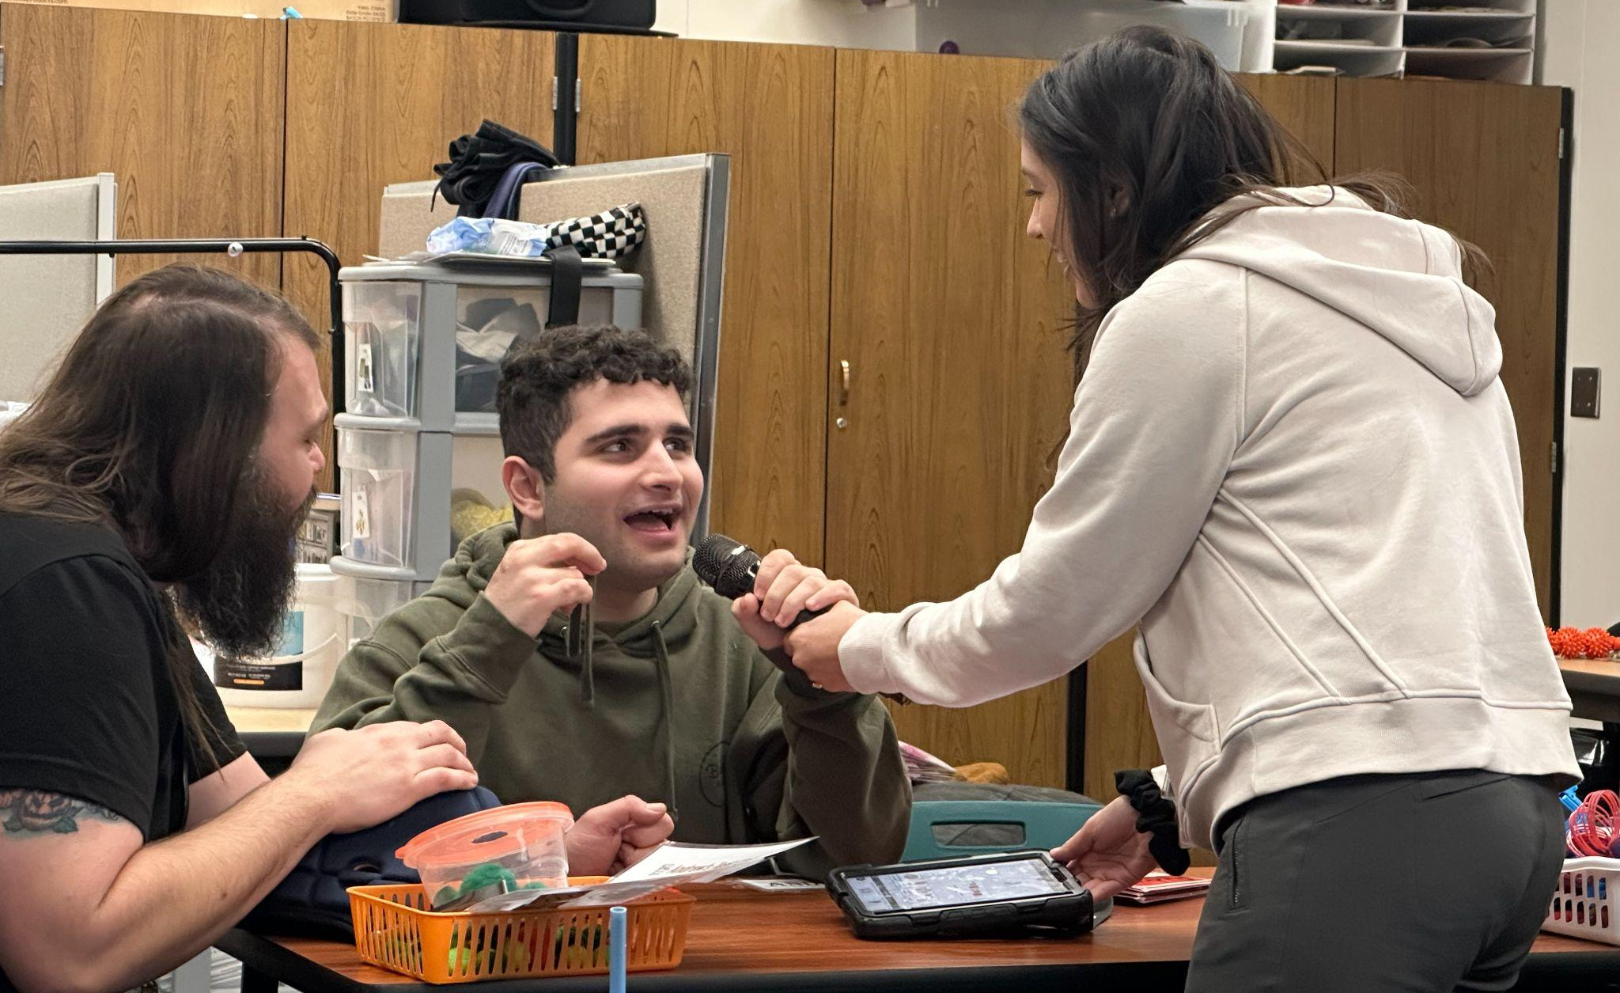

Slide 12
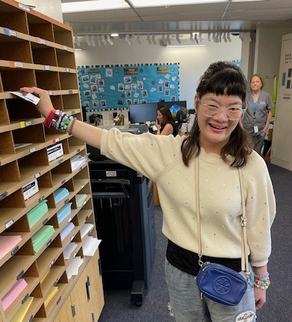
Work Experience
All students participate in work experience. At IATP students participate in work experience by volunteering and in-district locations, on-site or at non-profit businesses.
WorkAbility and/or Department of Rehabilitation program called Transition Partnership Program (TPP).
All students learn soft and hard job skills while at IATP!
Notes:
Name experiences, indicate that students shift between them, they change and rotate on and off campus.

Slide 13
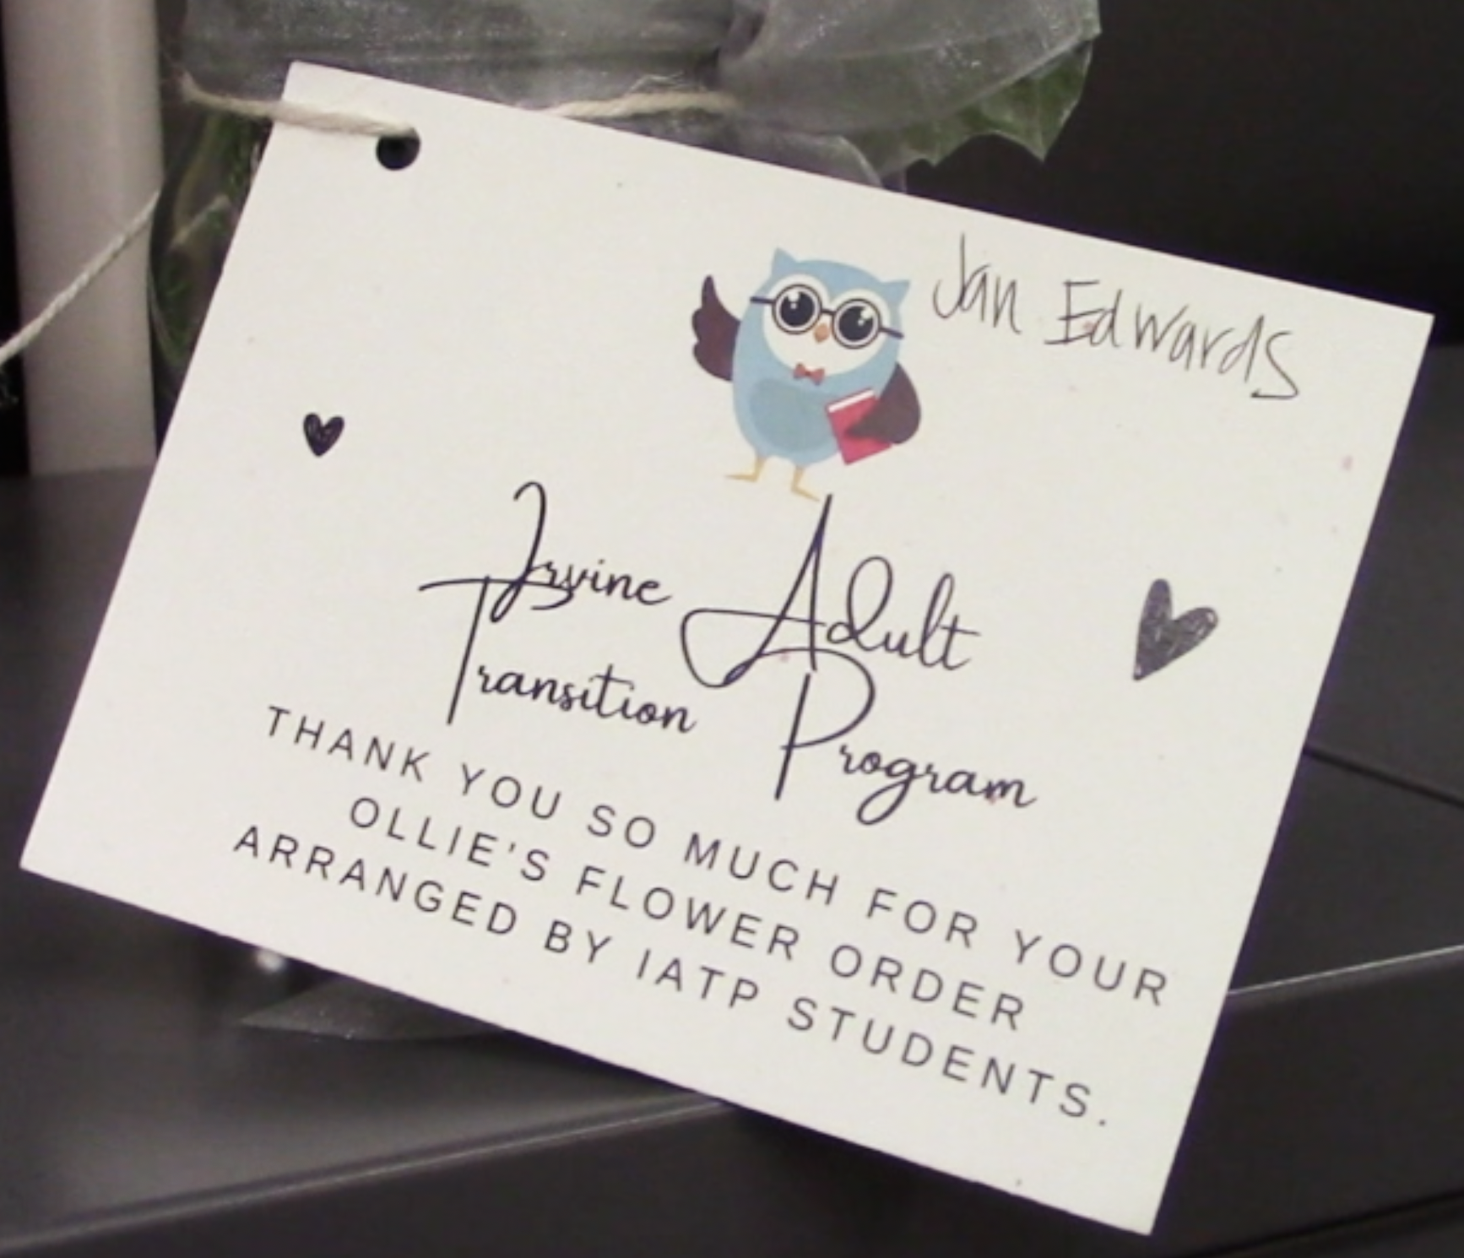
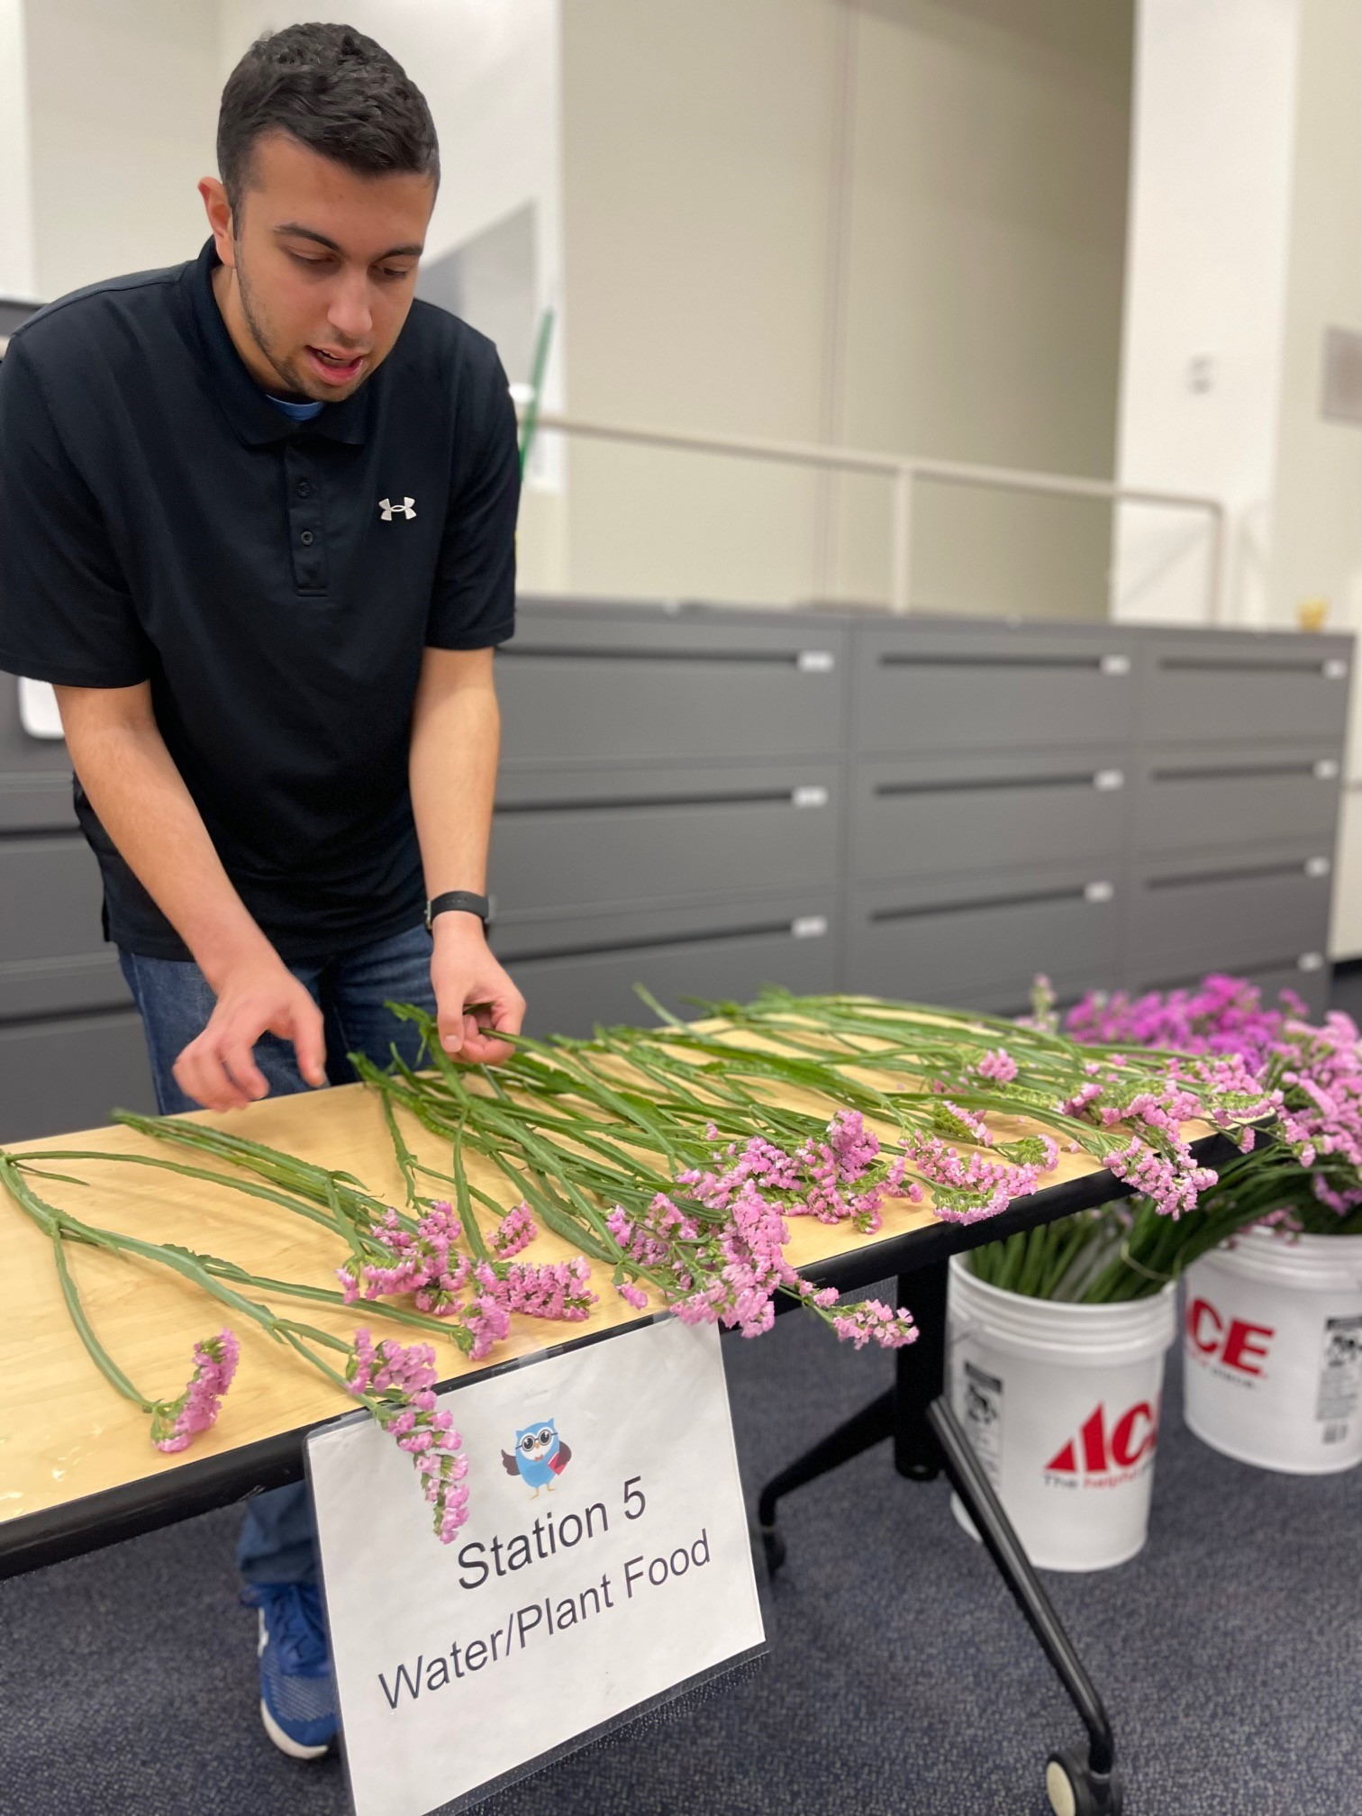
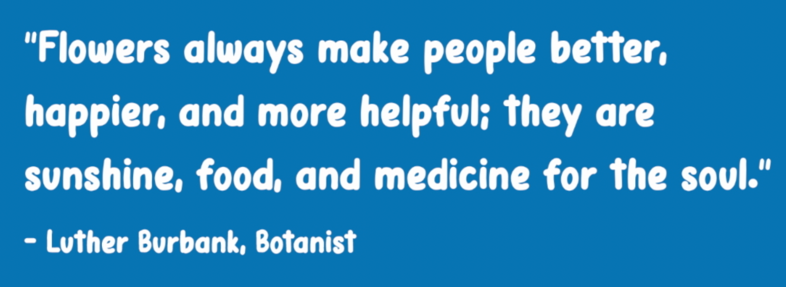
Ollie’s Flower
Delivery Service

Slide 14
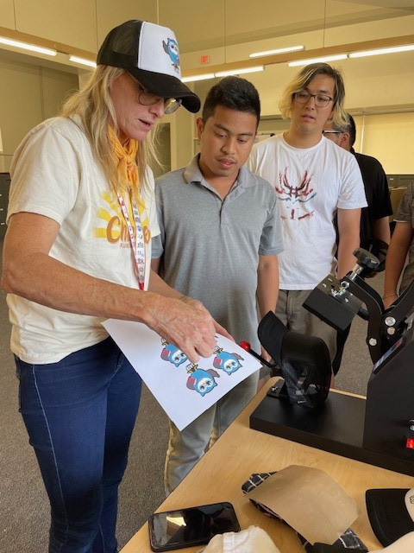
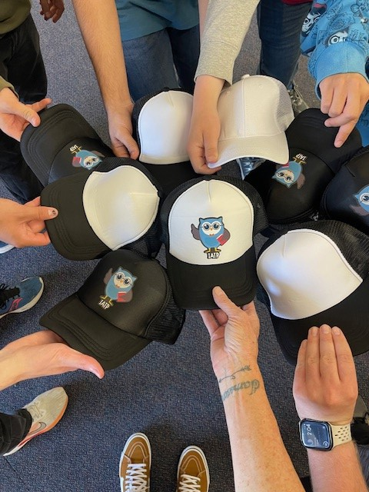
Printing Business

Slide 15
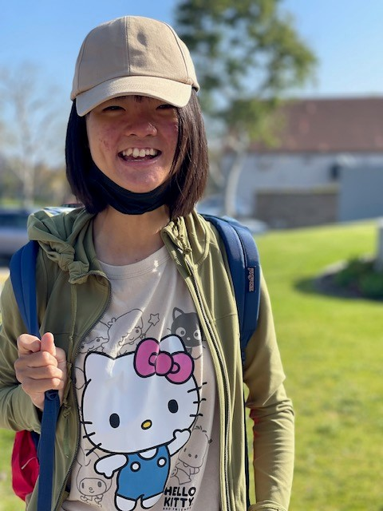
Social Emotional Learning
Mindfulness
Multiple lessons/times of the day
Engaging social opportunity for students and staff
Guided meditation, relaxation techniques, self-regulating strategies
Standing yoga and slow motion tai chi in class
Panorama Survey

Slide 16
Social Opportunities and Events at IATP
Social Electives
Fall Festival
Thanksgiving Luncheon
Cultural Potluck
Community Helpers Carnival
Pickleball
Talent Show
Movie Night
Volunteer for Inclusion Matters and CAC events

Slide 17
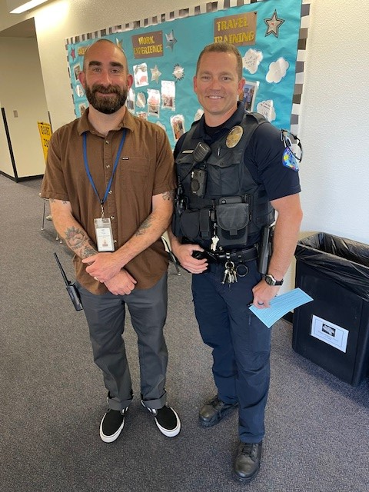
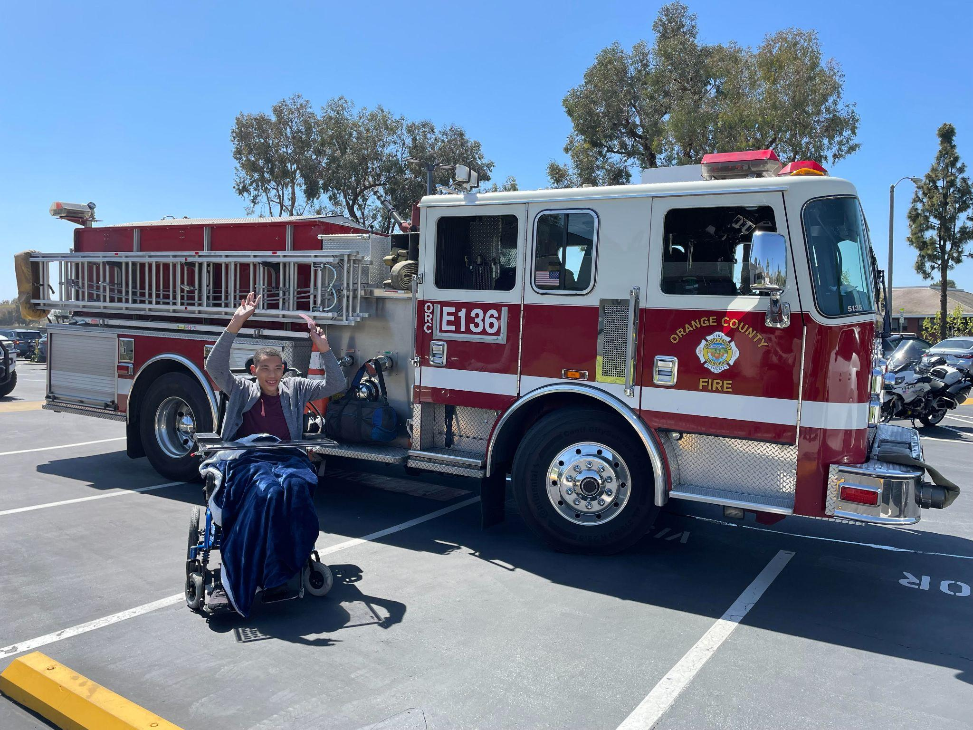
SEALS
Safety Program in collaboration with Irvine Police Department

Slide 18
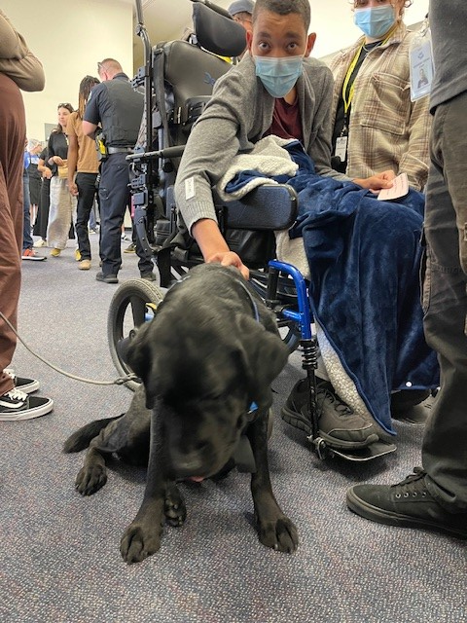
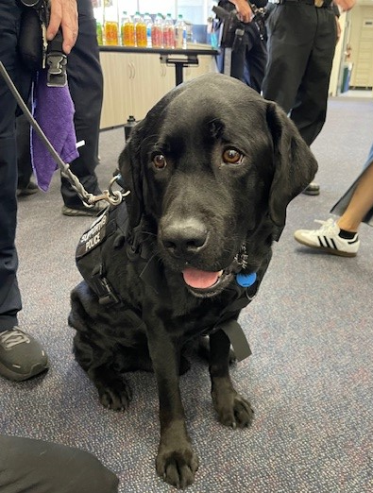
Irvine K-9 Support Dogs

Slide 19
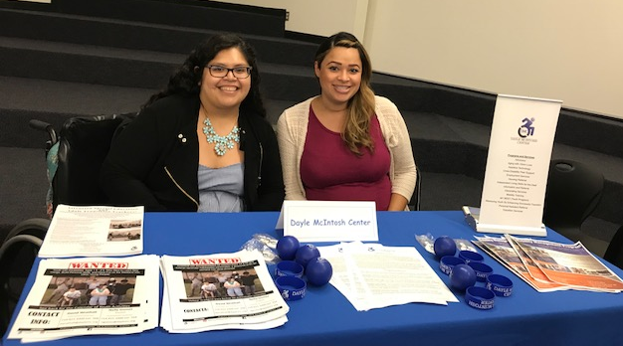
Connect Families
to Local Resources
Website http://www.iusd.org/iatp/
Orange County Adult Transition Task Force (OCATTF)
Orange County Local Partnership Agreement (OC LPA)
Regional Center of Orange County (RCOC)
Department of Rehabilitation (DOR)
Dayle McIntosh Center (DMC)
Coastline Community College/Rancho Santiago College

Slide 20
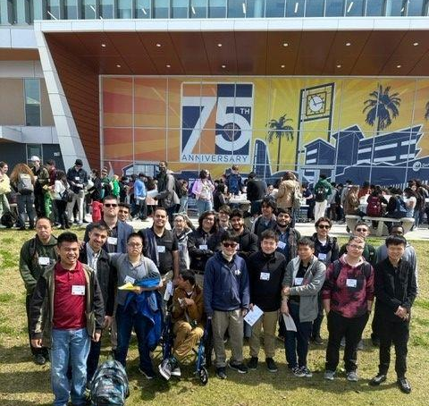
Adult Agencies &
Community Colleges

Slide 21
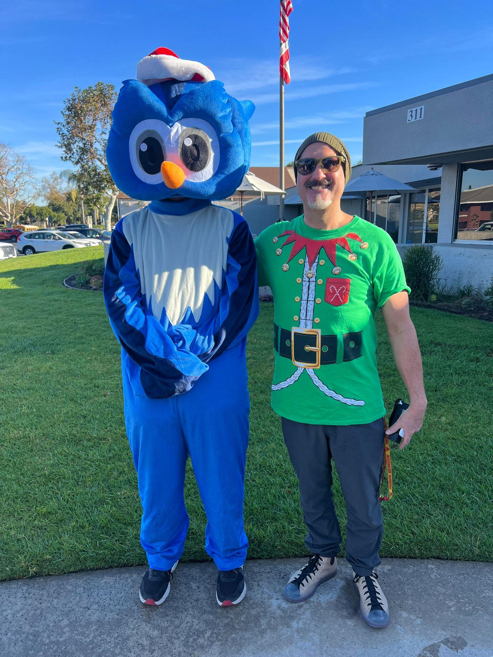
Socials at IATP:
Owl Network News, Instagram & Website
Website:
https://iatp.iusd.org/
Owl Network News
https://drive.google.com/file/d/1r_Gw3US2WNlA521XGQkkX6b08SqC4hqi/view
Notes:
Play Video

Slide 22
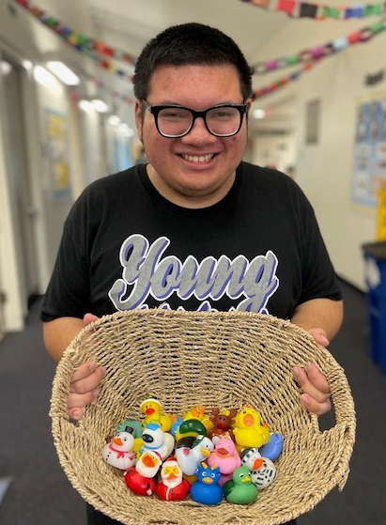
Exiting IATP
Work with RCOC
Connect to adult service agencies
Find an Adult Service Provider
Explore Department of Rehabilitation
Collaboration with RCOC
Student’s Transition Planning Portfolio
Person Driven Plan-OCPLA
Exit IEP/Graduation

Slide 23
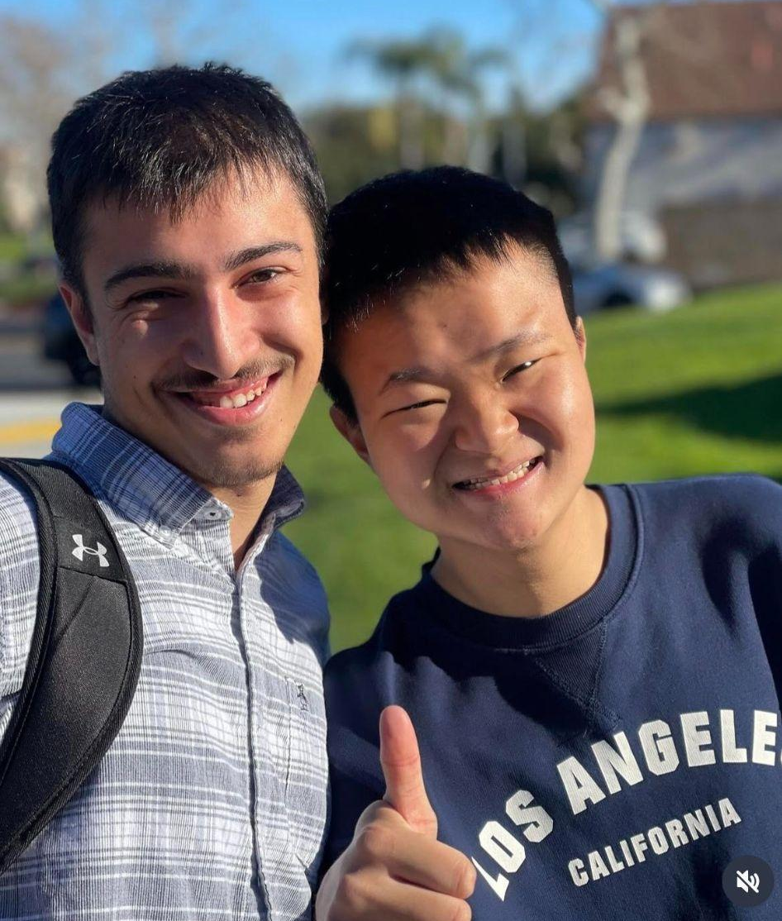
Next Steps
Transition Activities
Sign Addendum/IEP proposed services
Attend ESY if recommended
Complete Data Confirmation Process in the summer!
Follow us on Instagram @ Irvine_iatp
Website: https://iatp.iusd.org/

Slide 24
Thank you!
If you have any questions, please feel free to call us here at 949-936-8150

